Slide 1

Mini Project-I (K24MCA18P) Odd Semester Session 2024-25
PROJECT – QUIZ APPLICATION
Team Leader : RAHUL-2426MCA1656
Member-1 : RISHU AGARWAL-2426MCA215
Member-2 : RIYA-2426MCA511
Project Supervisor:
MS. DIVYA SINGHAL
(Assistant Professor)

Slide 2
Content
Introduction
Literature Review
Objective of the Project
Technology
Hardware Requirements (Development Environment, Server requirement, Client requirement.
Software Requirements (Language and Platforms like Frameworks, VS code, Android Studio and
Jupiter notebook etc. )
Modules
Workflow
Reports (For Example: Project : Student Monitoring System, so reports like: Student Marks,
Subjects, companies visit, and student appears in placement etc.)
References
Notes:
Font Styles: Times New Roman + Font Size: 25

Slide 3
Introduction
The Quiz Application is an interactive web platform that allows users to register, log in, and participate in quizzes on various programming and web development topics, including HTML, CSS, JavaScript (JS), C Language and Java. The application begins with a user registration process followed by login authentication. Once authenticated, users can choose a quiz section based on their interests.
Each quiz contains multiple questions related to the chosen topic, and upon completion, the user is presented with a results page showcasing their performance. The main objective of this project is to create an easy-to-use and efficient quiz system where users can test their knowledge, track progress, and learn interactively.
Notes:
Font Styles: Times New Roman + Font Size: 25

Slide 4
Literature Review
Brief summary of existing quiz platforms that is to help the use for strong their fundamentals.
Examples of popular online quiz applications (e.g. W3 School, Kahoot, Quizlet, sololearn).
This platform is very easy to use with interface and customized quiz
Notes:
Font Styles: Times New Roman + Font Size: 25

Slide 5
Objective of the Project
Objectives:
To create a user-friendly quiz platform.
Enable users to test their knowledge on HTML, CSS, JS, C and Java language.
Provide instant feedback and results after quiz completion.
Ensure secure user registration and login.
Notes:
Font Styles: Times New Roman + Font Size: 25

Slide 6
Technology (Hardware Requirements)
Development Environment:
Laptop or desktop with at least 4 GB RAM and 2 GHz processor.
Preferred OS: Windows, macOS, or Linux.
Client Requirements:
Browser-based, accessible from any modern web browser.
Notes:
Font Styles: Times New Roman + Font Size: 25

Slide 7
Technology (Software Requirements)
Front-end: HTML5, CSS3, JavaScript are required for UI (User interface).
Back-end: Node.js and Express.js are using for backend.
Database: MySQL for storing user and quiz data.
IDE & Tools: Visual Studio Code for code editing.
Notes:
Font Styles: Times New Roman + Font Size: 25

Slide 8
Modules
User Authentication:
User have to creating a new accounts.
User Login: Secure login system.
Quiz Section: Choose quiz by category (HTML, CSS, JS, C, Java).
Quiz Logic: Present questions, track answers, submit, and calculate results.
Result Page: Display the quiz results with user scores after completion quiz.
Notes:
Font Styles: Times New Roman + Font Size: 25

Slide 9
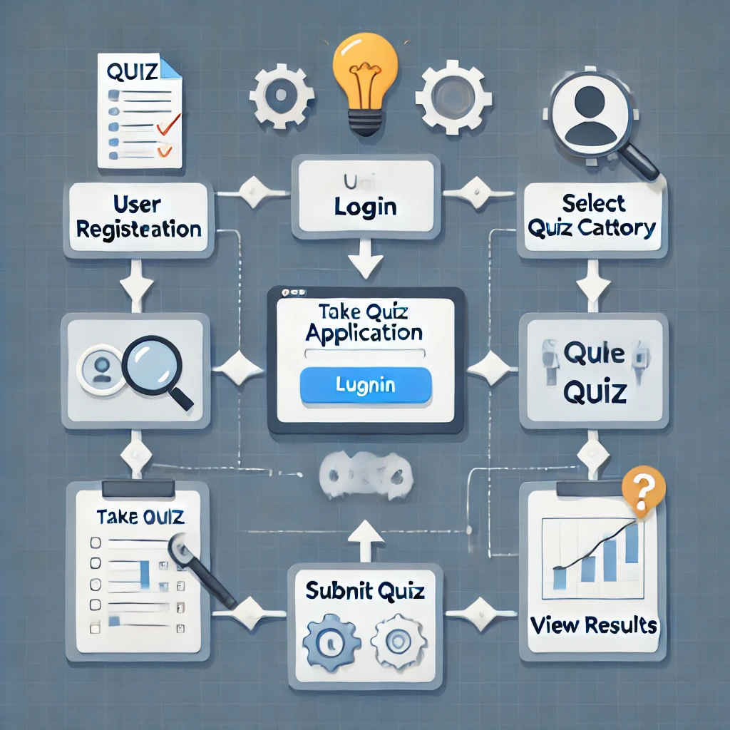
Workflow/Gantt Chart
Notes:
Font Styles: Times New Roman + Font Size: 25

Slide 10
Reports
User Report: Number of quizzes taken, total score, accuracy.
Quiz Reports: Popular quiz sections (HTML, CSS, Java), performance breakdown.
Admin Reports: Total users registered, quiz completion stats.
Notes:
Font Styles: Times New Roman + Font Size: 25

Slide 11
References
List of the references for any frameworks, tutorials, documentation
during the project.
Examples :
Node.js official documentation (For backend development).
Express.js guide.
W3Schools for HTML/CSS tutorials.
MySQL setup tutorials.
Notes:
Font Styles: Times New Roman + Font Size: 25

